Slide 1
Microservices Architecture
System Design Fundamentals - Architectural Patterns

Slide 2
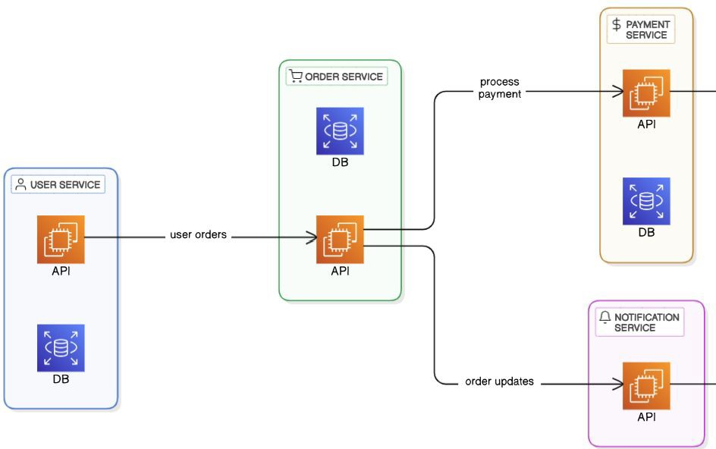

What is Microservices Architecture?
Deﬁnition: Microservices architecture is a software design pattern where applications are structured as a collection of small, loosely coupled services, each responsible for a speciﬁc function.
Characteristics:
  Independently deployable services
  Loosely coupled & modular
  Scalable & fault-tolerant

Slide 3
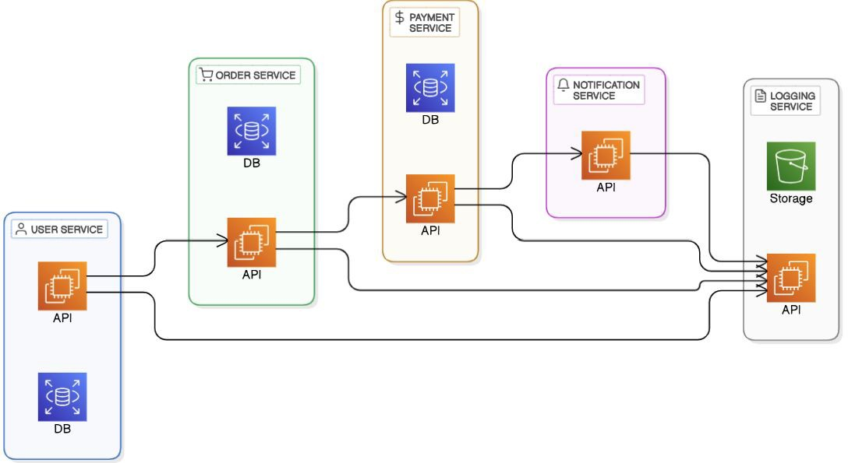

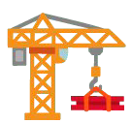
Identifying and Structuring Microservices
How to Identify Microservices?
  Business Capabilities: Each service should align with a speciﬁc business function (e.g., Payments,
Orders, Users).
Single Responsibility Principle: A microservice should do one thing well.
Data Ownership: Each microservice owns its own
database—avoid shared databases.
Independently Deployable: Should be deployable and scalable without aﬀecting others.
○
○
●
How to Structure Microservices?
Decompose by Business Domain: Use Domain-Driven Design (DDD) to group services logically.
Deﬁne Clear APIs: Services should communicate via
well-deﬁned APIs (REST, gRPC, or events).
Choose the Right Granularity: Avoid making microservices too large (monolith-in-disguise) or too small (high complexity).
Implement Observability: Use logging, monitoring, and
tracing to track service interactions.

Slide 4
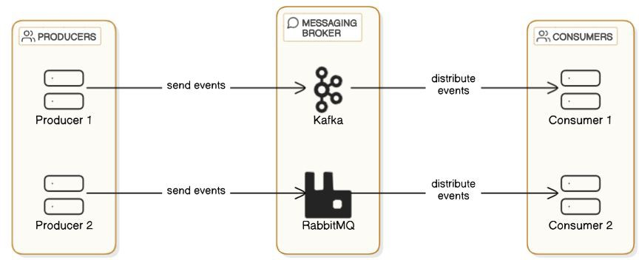
Communication in Microservices
Synchronous Communication:
  REST APIs (Simple, widely used, but high latency)
  gRPC (Eﬃcient, binary format, better performance)
Asynchronous Communication:
  Event-Driven Messaging (Kafka, RabbitMQ, SNS/SQS)

Slide 5

Challenges of Microservices
Data Consistency: Distributed databases → Eventual consistency
Distributed Tracing: Diﬃcult to debug & track requests
Network Overhead: More API calls → Increased latency
Security: Authentication, authorization, data protection

Slide 6
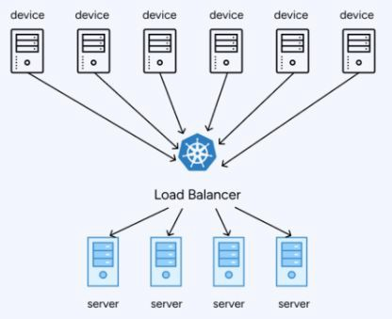
Scaling Strategies in Microservices
Horizontal Scaling: Add more instances of a service
Auto-scaling: Scale up/down automatically
Sharding & Database Scaling: Split databases for high-traﬃc services

Slide 7
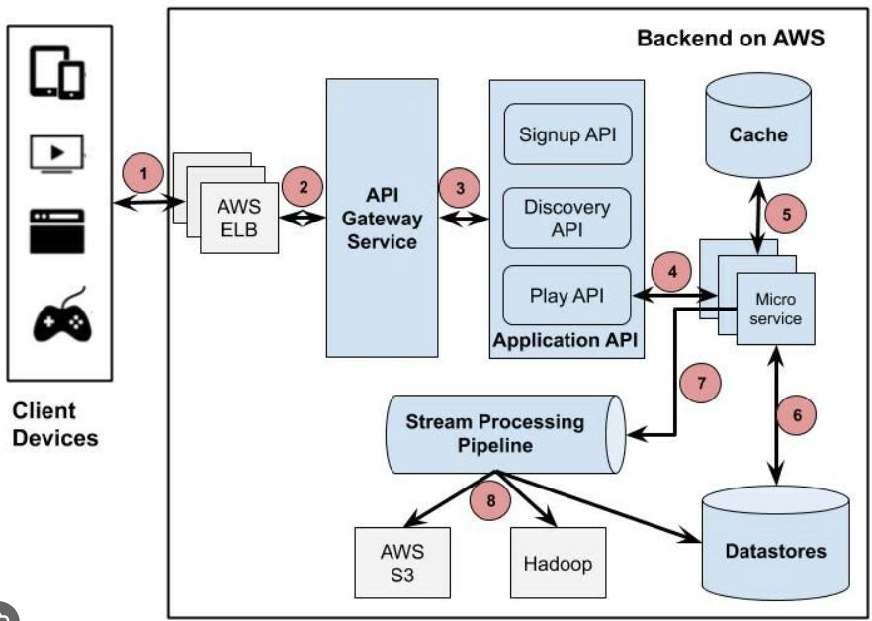
Real-World Examples of Microservices
Netﬂix: Uses microservices for video streaming & personalization
Uber: Scales ride-matching,
payments, and navigation independently
Amazon: Each service (search, payments, recommendations) runs separately

Slide 8
Interview Questions on Microservices
What are microservices, and how do they diﬀer from monolithic architecture?
What are the beneﬁts and challenges of microservices?
Explain the role of an API Gateway in a microservices system.
How do microservices communicate with each other?
How can you ensure data consistency in a microservices-based system?

Slide 9
Summary & What’s Next
Microservices = Scalability, Fault Tolerance, Faster Development
Requires API Gateway, Service Discovery, Load Balancing
Challenges: Data consistency, debugging, deployment complexity
Real-world usage: Netﬂix, Uber, Amazon
Next Lecture:
  Event-Driven Architectures!

